Slide 1
AMAZON PRODUCT REVIEW ANALYSIS
CAPSTONE PROJECT
GROUP 10
1-CHANNAPPA MOMDI
2-APRNA
3-MANAS GHODKE
4- VAMSHIKRISHNA NARMULA
5-KOUSTAV BANERJEE

Slide 2
OBJECTIVES
Analyzing given reviews of customers , making an understanding of customers sentiments and the effect of sentiment on sales and product trends.
Customer retention on basis of reviews
Product recommendation
Future Forecast
Identifying business trends

Slide 3
AMAZON PRODUCT REVIEW ON GROCERY AND GOURMET CATEGORY

Slide 4
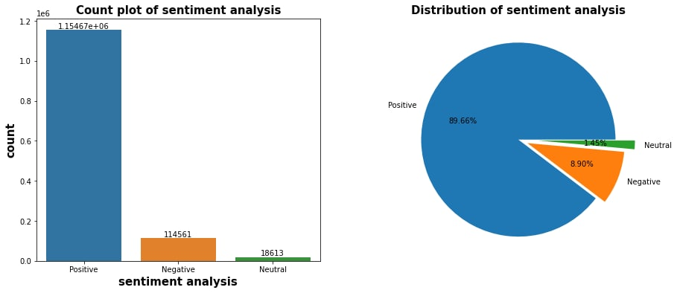
Customer reviews consists of majority of positive reviews , with almost 89.66% of positive reviews out of total . This depicts the imbalance of sentiment in reviews.

Slide 5
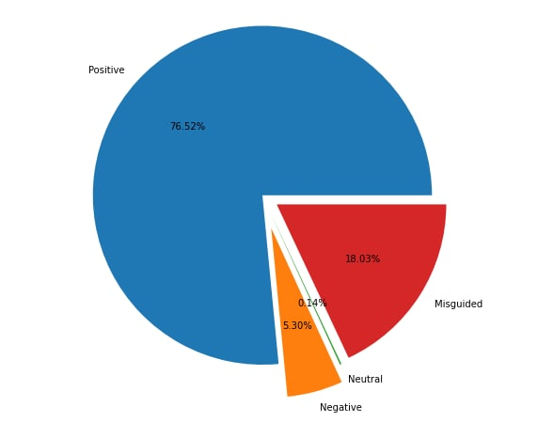
ANALYSIS ON SENTIMENT AND OVERALL RATING
The misguided reviews are of 18.03% which are not helpful for the customers to buy any product
The positive reviews are 76.52% and negative reviews are 5.3% which helps the customer to buy any product

Slide 6
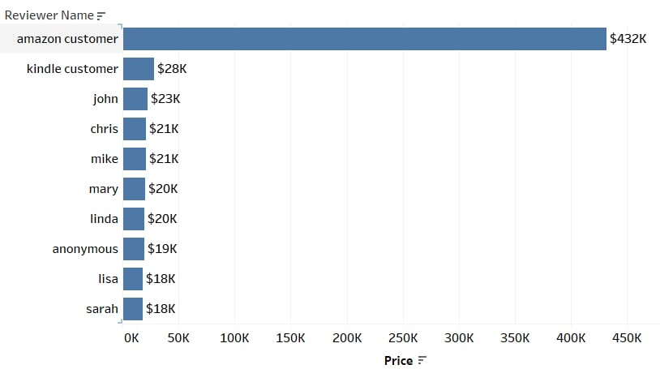
TOP 10 CUSTOMERS WITH HIGHEST SPENDING
These are the top 10 customers with major spendings for buying products on amazon.
They can be offered special discounts, coupons and offers to help avoid retention of these loyal customers.
Product quality should be maintained to keep a long term positive relation with the loyal customers

Slide 7
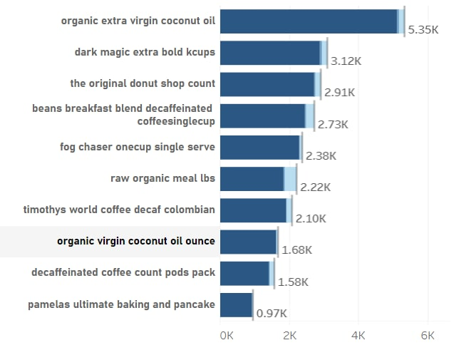
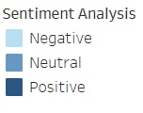
TOP 10 PRODUCTS WITH MOST REVIEWS
Approximately all the top10 products have almost 90% positive reviews.
Coconut oil & extra bold kcups seems to be most popular product. Hence Amazon can increase inventory for this products.

Slide 8
AMAZON PRODUCT REVIEW ON HOME & KITCHEN

Slide 9

Customer reviews consists of majority of positive reviews , with almost 89.24% of positive reviews out of total . This depicts the imbalance of sentiment in reviews.

Slide 10
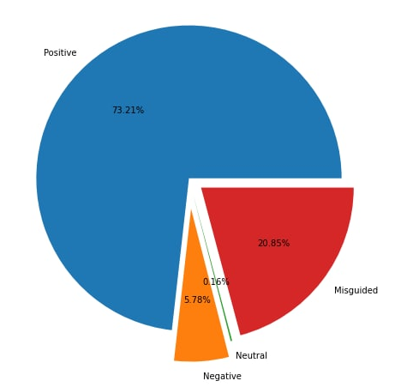
ANALYSIS ON SENTIMENT AND OVERALL RATING
THE MISGUIDED REVIEWS ARE OF 20.85% WHICH ARE NOT HELPFUL FOR THE CUSTOMERS TO BUY ANY PRODUCT
THE POSITIVE REVIEWS ARE 73.21% AND NEGATIVE REVIEWS ARE 5.78% WHICH HELPS THE CUSTOMER TO BUY ANY PRODUCT

Slide 11
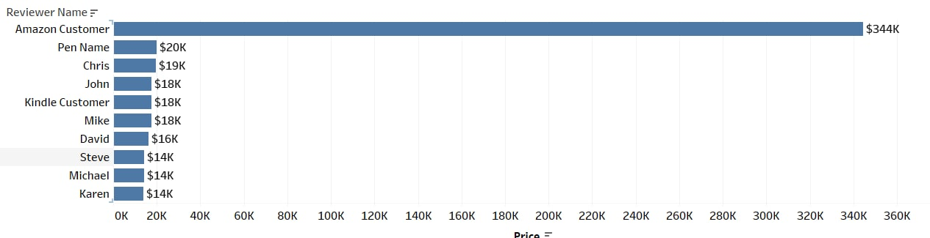
TOP 10 CUSTOMERS WITH HIGHEST SPENDING
These are the top 10 customers spending most money for buying products on amazon so we can offer them with discounts and special offers to attract them for buying more products

Slide 12
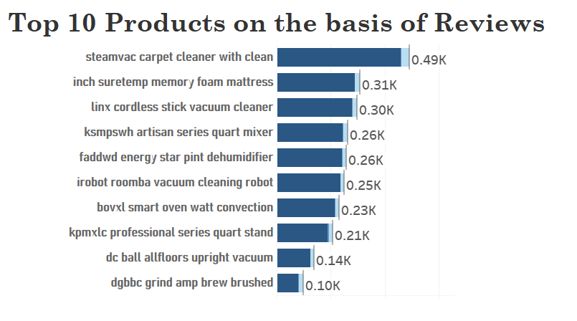
TOP 10 PRODUCTS WITH MOST REVIEWS
Top product have majority of positive reviews from the customer
Carpet cleaner, foam mattress are two most popular products amongst all.
All these products can be put more on marketing and notification to keep up the popularity.

Slide 13
BUSINESS PROSPECTS
From Time Series analysis we found that in the months from October to January every year sales increases.
This might be due to special occasions during that time of year. So special offers should be given to customers and more marketing for products.
The Loyal customers on basis of top purchases and reviews are Chris, Amazon customer, John, Anonymous, Kindle customer
The products with most negative reviews and bad ratings are Ekobrew Cup Refillanle cup, Raw Organic Milk, French Vanilla Count Single Serve, Beans Breakfast Blend Decaffinated Cofee Single Cup

Slide 14
BUSINESS SOLUTIONS
Giving Special Offers and Discount during Festive season to increase more customer involvement
Promoting the positively reviewed and good rated products more on the online platform
Giving discounts and special offers to the loyal customers on the basis of top purchases and reviews

Slide 15
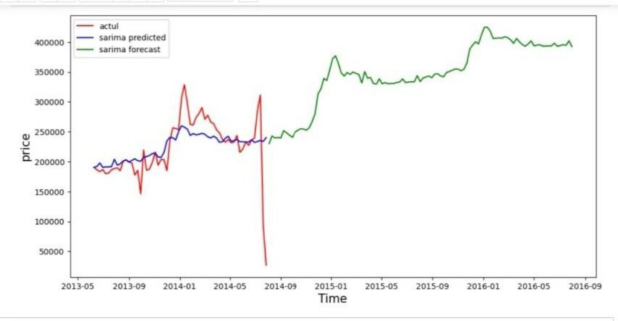
FORECASTING PRODUCT PRICE FOR THE FUTURE
It can be observed that there is increase in trend for forecast.
It can be forecasted that product prices may increase in the future, which will affect the increase in revenue over the upcoming years

Slide 16
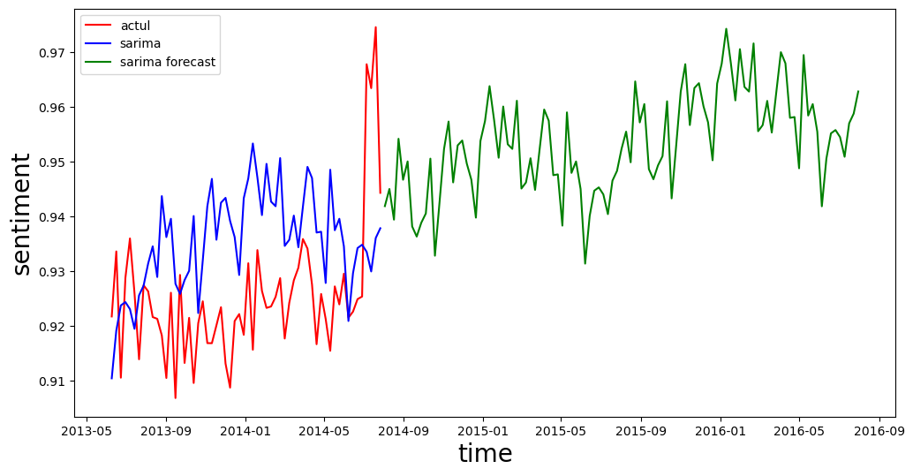
FORECASTING CUSTOMER SENTIMENT FOR FUTURE
It can be observed that there is increase in trend for forecast.
We can propose that customer attachment of the products with amazon may increase with respect to time.
As the reviews increase , we get more information on customers sentiments towards the product and make changes towards the problems causing negative sentiments for the products.

Slide 17
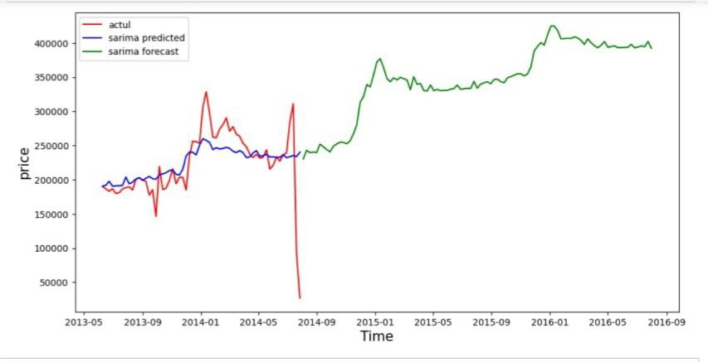
FORECASTING PRODUCT PRICE FOR THE FUTURE
It can be observed that there is increase in trend for forecast.
It can be forecasted that product prices may increase in the future, which will affect the increase in revenue over the upcoming years.

Slide 18
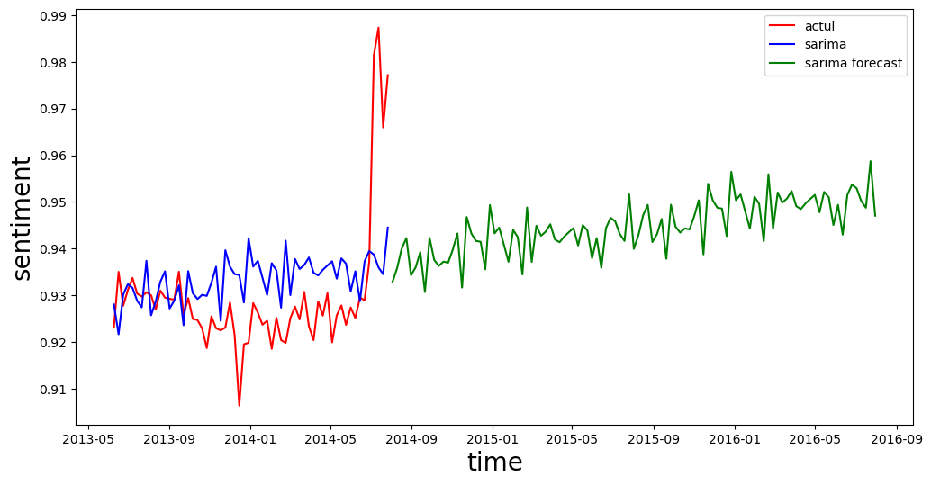
FORECASTING CUSTOMER SENTIMENT FOR FUTURE
It can be observed that there is increase in trend for forecast.
We can propose that customer attachment of the products with amazon may increase with respect to time.
As the reviews increase , we get more information on customers sentiments towards the product and make changes towards the problems causing negative sentiments for the products.

Slide 19

THANK YOU

